Slide 1
AAUW-IL, Inc. State Convention April 19-20, 2024

Slide 2
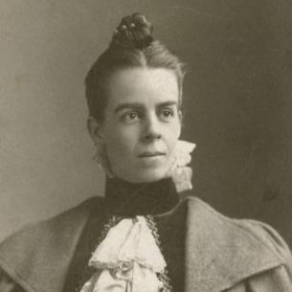
1881
Marion Talbot and Ellen Swallow Richards met with 15 women in Boston to form what would become the American Collegiate Association, the precursor to the American Association of University Women
1889
Chicago becomes the 8th branch of the ACA
1892
ACA founder Miss Marion Talbot becomes the country’s first dean of women at the University of Chicago and served as a staunch member of the Chicago Branch until her death in 1948

Slide 3
1915
Delegates from five Illinois branches met in one of the first State conferences ever held.
1921
The Southern Association of College Women Merged with the Association of College Alumnae and the name was changed to The American Association of University Women.
1924
At the Invitation of the Chicago Branch, delegates met with Sectional Director Miss Frances Perkins to form a State Organization.

Slide 4
1925
The first annual meeting was held in Jacksonville with delegations from seven branches: Jacksonville, Carthage, Champaign-Urbana, Chicago, East St. Louis, Elgin, and Springfield.
1926
A mimeographed State Division Newsletter for branch Presidents was undertaken. Annual dues of 10 cents per member were voted “to cover such expenses as printing and postage.”
1931
The first venture into the field of public relations was through representation on an Inter- organization Committee: The Illinois Women’s Conference on Legislation.
1939
Attainment of the $30,000 Marian Talbot Endowment was announced at National Convention in Denver.

Slide 5
Celebrating 100 years of empowering women!
AAUW-IL. 100th State Convention

Slide 6
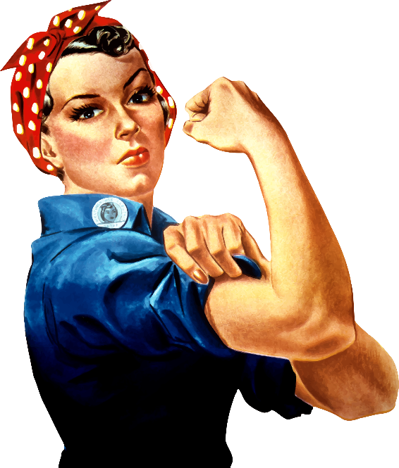
1940s
1942:The guidance project culminated with a national level distribution of “The Story of Illinois Guidance Project.”
1950s
1951: Dues were raised to 75 cents to cover the cost of the news bulletin, renamed the University Woman.
1944: The State Division was now represented on statewide committees concerned with child labor and child adoption. The Handbook on School-Community Discussion Groups was prepared and distributed.
1945: Sufficient funds accumulated in reserve for an investment in a $500 War Bond. The Gateway Amendment was actively supported, and the State Division was represented on the Illinois Committee for Constitutional Revision.
1954: Fellowships contributions passed the $11,000 mark per year. A “Drive-In Conference” on teachers for Illinois classrooms received national recognition. Thirty-one branches cooperated in a national study of “Taxation and the Financing of Our Schools.”
1956: The Illinois State Division Was host to the 14th Biennial Regional Conference in Chicago, with over 1,000 members from the five-state Northeast Central Region in attendance.

Slide 7
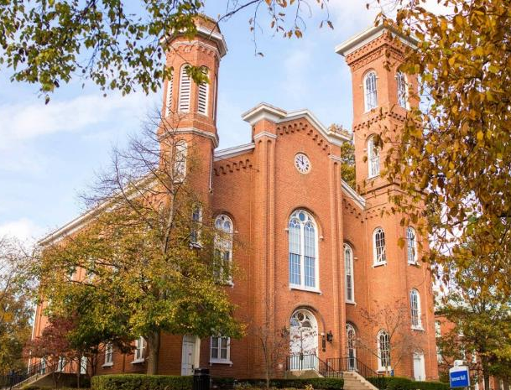
1960s
1960: Illinois reached 100% of its $83,310 goal for the new AAUW Educational Center and became the first State in the Northeast Central Region to attain the goal — 16th in the Country.
1970s
1974: The Golden Jubilee was celebrated with a gala convention in Jacksonville. Priority continued to be ERA, and the ISD promoted February 15, the birthday of Susan B. Anthony, pioneer American feminist, for a calendar place of honor.
1961: The Higher Education Project started to study, through branch surveys of local high schools, the educational intentions of senior high school girls in the upper 50% of graduating classes.
1963: Legislatively, Illinois branches helped with the passage of the judicial amendment to the Illinois Constitution.
1977: A Leadership Directory, listing highly qualified Illinois women, was compiled by the ISD and presented to the governor for use in making appointments. Husbands’ names and initials will no longer be used in the Sate Directory.

Slide 8
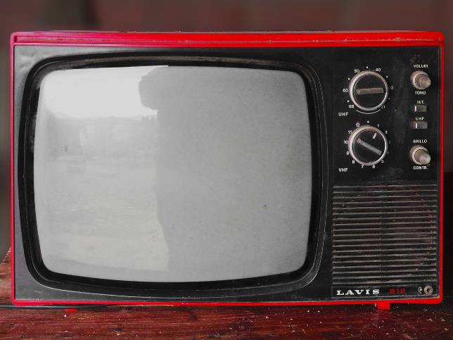
1980s
1983: “Women Advocating Action” was the theme for the biennium. Branches networked with other organizations in the nationwide “Get Out the Vote Project.”
1984: Illinois received awards for ranking third in the nation in EFP giving and second among newsletters of Divisions having over 5,000 Members. The Fall Conference, “Put Your Votes Where Your Rights Are,” featured Illinois candidates for the U.S. Senate, Congressman Paul Simon and Senator Charles Percy.
1988: The new State project, “Building Opportunity Through Mentoring: Teenage Single Parent Initiative,” began with training sessions for members interested in becoming mentors. ISD President Gail Ketz taped a public service spot for Chicago television, the first time Illinois Division was on a major television network. VoLT Training took place throughout the State under the leadership of Dr. Patricia Smith-Pierce.
1986: Several Illinois Division Members traveled to New Zealand to the IFUW Conference. Illinois members participated in the “Equity by 2000” Conference in Washington, D.C. Branches participated in the Equity Action Project prior to the November elections.

Slide 9
Empowering Women!

Slide 10
1990s
1990: The State Convention held in Downers Grove, IL with the theme “Visions of Our Future,” had as keynote speaker AAUW Executive Director Dr. Anne Bryant, who introduced the new issue, “AAUW Initiative for Educational Equity.” The Association Convention in Portland saw Illinois ranked second nationwide in EFP giving with over $110,000.
1994: FaIl Conference, “Educational Equity: A Journey to Justice,” was opened to the public and marketed to non-members as well.
1995: AAUW-IL, Inc. members attended the IFUW Triennial Conference in Yokohama, in August and the United Nations Fourth World Conference on Women in Beijing in September.
1996: AAUW-lL, Inc. contributes record-breaking $154,000 to the Educational Foundation. Illinois was recognized as a 6-Star State by the Association.

Slide 11
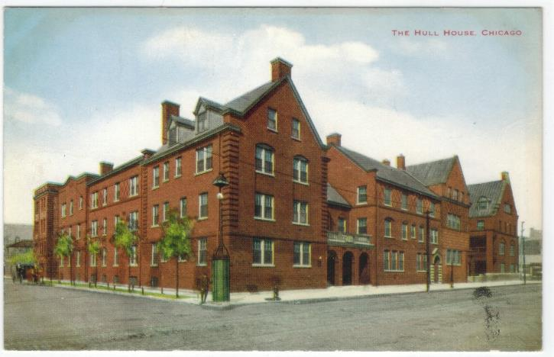
2000s
2002: The opportunity to become the 36th state to ratify the Equal Rights Amendment was not achieved. The state newsletter, the LINK, was published in 2 paper versions and 2 versions on the web site.
2004: The successful Legacy Circle Pilot Program in association with the Association, Educational Foundation and the Legal Advocacy Fund was launched in the fall of 2004 at each of the five separate District Meetings.
2006: The 125th Anniversary of AAUW was celebrated across the state. Illinois was recognized for being in the top ten states for giving for both EF and LAF at Association Convention in Washington D. C. and in Phoenix, AZ. Two members were recognized as Founding Mothers, Barbara Wyne and Marla Kim Benziger.
2008: In December 2008, AAUW-IL cosponsored a brunch at Hull-House with the Women’s International League for Peace and Freedom to celebrate the second annual Jane Addams Day in Illinois.

Slide 12
2010s
2010: At the AAUW National Convention in Washington D.C., approximately 100 members from Illinois attended. The “Big Teal Machine” as coined by Lisa Maatz, AAUW Public Policy Director, took over Capitol Hill. More than 250 offices were visited and members met with their senators, representatives and aides from all 50 states.
2012: Illinois had been awarded a public policy grant and the services of a field coordinator to focus on the Get Out The Vote (GOTV) Campaign
2015: In 2015 the State Board also approved the LEG UP Grants to support branch programming, such as Rockford sponsorship of an Elect Her event at Rockford College and Springfield’s STEM conference. Pay Equity Day and Jane Addams Day recognitions were also supported by LEG UP grants.
2018: Our big legislative success was Illinois passage of the Equal Rights Amendment in May 2018. AAUW worked with many other like-minded organizations for passage of ERA. A J Conroy, an AAUW member, developed an ERA Activity book that was distributed to all our state legislators. All four Fall Conferences celebrated significant branch anniversaries: Chicago, Inc (130 years), Aurora (100 years), Rockford (90 years), Waukegan (90 years), Belleville (80 years), Peoria (80 years), Elmhurst (80 years), Riverside (70 years), Downers Grove (70 years), Deerfield (60 years), Arlington Heights (60 years), Lombard (60 years), Glenview (50 years), and Jane Addams (10 years).

Slide 13
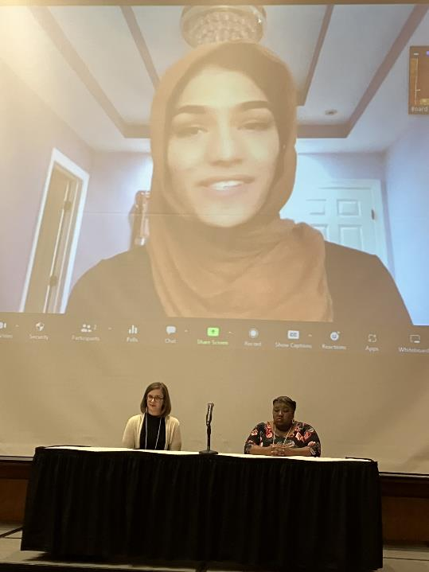
2010s
2020: Due to the COVID pandemic the AAUW Regional convention was canceled.
2021: “Equity Empowers Speak Out for Equity!” AAUW-IL State Convention was held virtually. AAUW-IL continues to support reproductive rights in Illinois with the successful repeal of the Parental Notification Act.
2022: AAUW, IL, Inc. joined an Amicus Brief along with 26 other organizations calling for publication of the ERA as the 28th Amendment. The threshold was met but ERA was blocked from becoming part the Constitution. AAUW-IL reconvened face-to-face at the, AAUW-IL State Convention “Together Again! All in for Equity”. Title IX celebrates 50 years in June.
2023: AAUW-IL State Convention focused on “Everyone is a Leader for Equity”. AAUW Central States Regional Conference: “Celebrating AAUW—Reaching New Heights Together”, 156 AAUW members participated with 25 of those from AAUW-IL. The ABCD Book discussion on families fighting poverty, met virtually throughout the year. Public Policy for AAUW-IL was actively involved with a statewide coalition to protect library and school board elections in April.
2024: AAUW-IL 100th State Convention, "Celebrating 100 Years of Empowering Women".
AAUW-IL State Convention, 2023

